Slide 1
SQL

Slide 2
Retrieval Queries in SQL
Basic form of the SQL SELECT statement is called a SELECT-FROM-WHERE block
SELECT <attribute list>
FROM <table list>
WHERE <condition>
– <attribute list> is a list of attribute names whose values are to be retrieved by the query
– <table list> is a list of the relation names required to process the query
– <condition> is a conditional (Boolean) expression that identifies the tuples to be retrieved by the query

Slide 3
SQL Queries
A query in SQL can consist of up to six clauses, but only
the first two, SELECT and FROM, are mandatory. The
clauses are specified in the following order:
SELECT <attribute list>
FROM <table list>
[WHERE <condition>]
[GROUP BY <grouping attribute(s)>]
[HAVING <group condition>]
[ORDER BY <attribute list>]

Slide 4
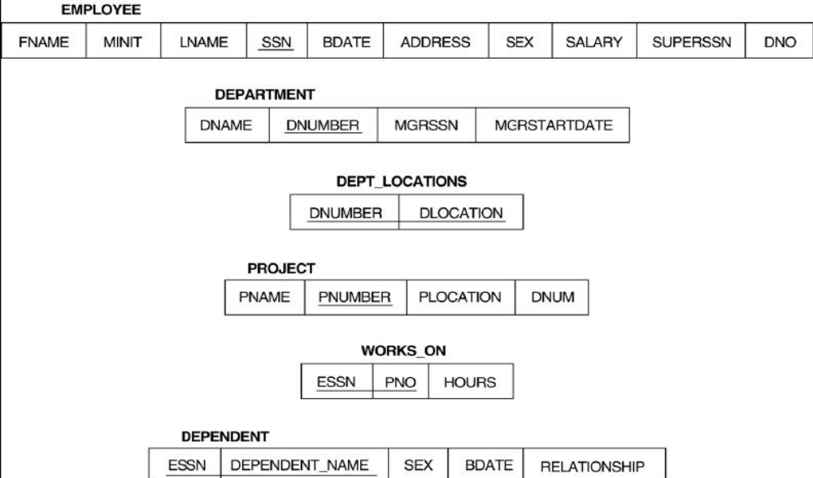
Relational Database schema
Examples from book - Elmasri , Navathe

Slide 5


Slide 6
Simple Queries
Query 0: Retrieve the birthdate and address of the employee whose
name is ‘Mikel B. Smith'.
Q0: SELECT BDATE, ADDRESS
FROM EMPLOYEE
WHERE FNAME=' Mikel' AND MINIT='B’
AND LNAME='Smith’
Query 1: Retrieve the name and address of all employees who work for
the ‘CSE ' department.
Q1: SELECT FNAME, LNAME, ADDRESS
FROM EMPLOYEE, DEPARTMENT
WHERE DNAME=‘CSE' AND
DNUMBER=DNO

Slide 7
Contd..
Query 2: For every project located in 'Stafford', list the project number, the
controlling department number, and the department manager's last name,
address, and birthdate.
Q2: SELECT PNUMBER, DNUM, LNAME, BDATE, ADDRESS
FROM PROJECT, DEPARTMENT, EMPLOYEE
WHERE DNUM=DNUMBER AND MGRSSN=SSN AND PLOCATION='Stafford'
Query 3: For each employee, retrieve the employee's name, and the name
of his or her immediate supervisor.
Q3: SELECT E.FNAME, E.LNAME, S.FNAME, S.LNAME
FROM EMPLOYEE E S
WHERE E.SUPERSSN=S.SSN

Slide 8
Contd..
Query 4: Make a list of all project numbers for projects that involve an
employee whose last name is 'Smith' as a worker or as a manager of
the department that controls the project.
Q4: (SELECT PNAME
FROM PROJECT, DEPARTMENT, EMPLOYEE
WHERE DNUM=DNUMBER AND MGRSSN=SSN AND LNAME='Smith')
UNION (SELECT PNAME
FROM PROJECT, WORKS_ON, EMPLOYEE
WHERE PNUMBER=PNO AND ESSN=SSN AND
LNAME='Smith')

Slide 9
Contd..
The comparison operator IN compares a value v with a set (or multi-set)
of values V, and evaluates to TRUE if v is one of the elements in V
Query 5: Retrieve the name of each employee who has a dependent
with the same first name as the employee.
Q5: SELECT E.FNAME, E.LNAME
FROM EMPLOYEE AS E
WHERE E.SSN IN (SELECT ESSN
FROM DEPENDENT
WHERE ESSN=E.SSN AND
E.FNAME=DEPENDENT_NAME)
Q5A: SELECT E.FNAME, E.LNAME
FROM EMPLOYEE E, DEPENDENT D
WHERE E.SSN=D.ESSN AND
E.FNAME=D.DEPENDENT_NAME

Slide 10
Contd..
EXISTS is used to check whether the result of a correlated nested query is empty (contains no tuples) or not
Q5B: SELECT FNAME, LNAME
FROM EMPLOYEE
WHERE EXISTS (SELECT *
FROM DEPENDENT
WHERE SSN=ESSN AND
FNAME=DEPENDENT_NAME)

Slide 11
Contd.. explicit (enumerated) set of values
It is also possible to use an explicit (enumerated) set of values in the WHERE-clause rather than a nested query
Query 6: Retrieve the social security numbers of all employees who work on project number 1, 2, or 3.
Q6: SELECT DISTINCT ESSN
FROM WORKS_ON
WHERE PNO IN (1, 2, 3)

Slide 12
Contd..
The CONTAINS operator compares two sets of values , and returns TRUE
if one set contains all values in the other set
Query 7: Retrieve the name of each employee who works on all the projects
controlled by department number 5.
Q7: SELECT FNAME, LNAME
FROM EMPLOYEE
WHERE ( (SELECT PNO
FROM WORKS_ON
WHERE SSN=ESSN)
CONTAINS
(SELECT PNUMBER
FROM PROJECT
WHERE DNUM=5) )

Slide 13
Contd..
SQL uses IS or IS NOT to compare NULLs.
Query 8: Retrieve the names of all employees who do not have supervisors.
Q8: SELECT FNAME, LNAME
FROM EMPLOYEE
WHERE SUPERSSN IS NULL
Note: If a join condition is specified, tuples with NULL values for the join attributes are not included in the result

Slide 14
Some Queries Cont. JOIN
Q: SELECT E.FNAME, E.LNAME, S.FNAME, S.LNAME
FROM EMPLOYEE E S
WHERE E.SUPERSSN=S.SSN
Can be written as:
QA: SELECT E.FNAME, E.LNAME, S.FNAME, S.LNAME
FROM (EMPLOYEE E LEFT OUTER JOIN EMPLOYEES
ON E.SUPERSSN=S.SSN)

Slide 15
Some Queries Cont. JOIN
Q9: SELECT FNAME, LNAME, ADDRESS
FROM EMPLOYEE, DEPARTMENT
WHERE DNAME='Research' AND DNUMBER=DNO
Can be written as:
Q9A: SELECT FNAME, LNAME, ADDRESS
FROM (EMPLOYEE JOIN DEPARTMENT
ON DNUMBER=DNO)
WHERE DNAME='Research’
Or as:
Q9B: SELECT FNAME, LNAME, ADDRESS
FROM (EMPLOYEE NATURAL JOIN
DEPARTMENT AS DEPT(DNAME, DNO, MSSN, MSDATE)
WHERE DNAME='Research’

Slide 16
Joined Relations Feature in SQL2
Query 2: For every project located in 'Stafford', list the project number, the
controlling department number, and the department manager's last name,
address, and birthdate.
Q2 B: SELECT PNUMBER, DNUM,
LNAME, BDATE, ADDRESS
FROM (PROJECT JOIN
DEPARTMENT ON DNUM=DNUMBER) JOIN
EMPLOYEE ON
MGRSSN=SSN) )
WHERE PLOCATION='Stafford’

Slide 17
AGGREGATE FUNCTIONS
Include COUNT, SUM, MAX, MIN, and AVG
Query 10: Find the maximum salary, the minimum salary, and
the average salary among all employees.
Q10: SELECT MAX(SALARY), MIN(SALARY), AVG(SALARY)
FROM EMPLOYEE
Query 11: Find the maximum salary, the minimum salary, and the average salary among employees who work for the 'Research' department.
Q11: SELECT MAX(SALARY), MIN(SALARY), AVG(SALARY)
FROM EMPLOYEE, DEPARTMENT
WHERE DNO=DNUMBER AND
DNAME='Research'

Slide 18
Group by
SQL has a GROUP BY-clause for specifying the grouping attributes, which must also appear in the SELECT-clause
Query 12: For each department, retrieve the department number, the number of employees in the department, and their average salary.
Q12: SELECT DNO, COUNT (*), AVG (SALARY)
FROM EMPLOYEE
GROUP BY DNO
Query 13: For each project, retrieve the project number, project
name, and the number of employees who work on that project.
Q13: SELECT PNUMBER, PNAME, COUNT (*)
FROM PROJECT, WORKS_ON
WHERE PNUMBER=PNO
GROUP BY PNUMBER, PNAME

Slide 19
Group by cont. Having
lThe HAVING-clause is used for specifying a selection condition on groups (rather than on individual tuples)
Query 14: For each project on which more than two employees work, retrieve the project number, project name, and the number of employees who work on that project.
Q14: SELECT PNUMBER, PNAME, COUNT (*)
FROM PROJECT, WORKS_ON
WHERE PNUMBER=PNO
GROUP BY PNUMBER, PNAME
HAVING COUNT (*) > 2

Slide 20
Summary of SQL Queries
(cont.)
The SELECT-clause lists the attributes or functions to be retrieved
The FROM-clause specifies all relations (or aliases) needed in the query but not those needed in nested queries
The WHERE-clause specifies the conditions for selection and join of tuples from the relations specified in the FROM-clause
GROUP BY specifies grouping attributes
HAVING specifies a condition for selection of groups
ORDER BY specifies an order for displaying the result of a query
A query is evaluated by first applying the WHERE-clause, then
GROUP BY and HAVING, and finally the SELECT-clause

Slide 21
More complex Select “SQL Server”
SELECT select_list
[ INTO new_table ]
FROM table_source
[ WHERE search_condition ]
[ GROUP BY group_by_expression ]
[ HAVING search_condition ]
[ ORDER BY order_expression [ ASC | DESC ] ]
From Clause:
[ FROM { < table_source > } [ ,...n ] ]
< table_source > ::=
table_name [ [ AS ] table_alias ] [ WITH ( < table_hint > [ ,...n ] ) ]
| view_name [ [ AS ] table_alias ]
| rowset_function [ [ AS ] table_alias ]
| OPENXML
| derived_table [ AS ] table_alias [ ( column_alias [ ,...n ] ) ]
| < joined_table >
< joined_table > ::=
< table_source > < join_type > < table_source > ON < search_condition >
| < table_source > CROSS JOIN < table_source >
| < joined_table >
< join_type > ::=
[ INNER | { { LEFT | RIGHT | FULL } [ OUTER ] } ]
[ < join_hint > ]
JOIN
Arguments
< table_source >
Select Clause:
SELECT [ ALL | DISTINCT ]
[ TOP n [ PERCENT ] [ WITH TIES ] ]
< select_list >
< select_list > ::=
{ *
| { table_name | view_name | table_alias }.*
| { column_name | expression | IDENTITYCOL | ROWGUIDCOL }
[ [ AS ] column_alias ]
| column_alias = expression
} [ ,...n ]

Slide 22
More complex Select “SQL Server” Cont.
Where Clause:
Having:
[ HAVING < search_condition > ]
[ WHERE < search_condition > | < old_outer_join > ]
< old_outer_join > ::=
column_name { * = | = * } column_name
Order By Clause:
[ ORDER BY { order_by_expression [ ASC | DESC ] } [ ,...n] ]
Group by clause:
[ GROUP BY [ ALL ] group_by_expression [ ,...n ]
[ WITH { CUBE | ROLLUP } ]
]
Compute Clause:
[ COMPUTE
{ { AVG | COUNT | MAX | MIN | STDEV | STDEVP
| VAR | VARP | SUM }
( expression ) } [ ,...n ]
[ BY expression [ ,...n ] ]
]

Slide 23
Compute
Row aggregate function | Result
AVG | Average of the values in the numeric expression
COUNT | Number of selected rows
MAX | Highest value in the expression
MIN | Lowest value in the expression
STDEV | Statistical standard deviation for all values in the expression
STDEVP | |Statistical standard deviation for the population for all values in the expression
SUM | Total of the values in the numeric expression
VAR | Statistical variance for all values in the expression
VARP | Statistical variance for the population for all values in the expression

